Slide 1
Module 5 : Lesson 7 Transformations – Caching

Slide 2
Caching
Spark DataFrames are by default recomputed each time you run an action on them
If you would like to reuse a DataFrame in multiple actions, you can ask Spark to cache it making future actions more than 10x faster
When you cache a DataFrame, Spark keeps the data in memory (or on local disk) so that it can be quickly retrieved the next time it is needed
Caching is especially useful when you need to perform multiple operations on the same DataFrame, as it eliminates the need to read the data from a disk each time
Caching is fault-tolerant such that if any partition of an DataFrame is lost, it will automatically be recomputed using the transformations that originally created it

Slide 3
Caching – cache()
Persists the DataFrame with the default storage level (MEMORY_AND_DISK)
DataFrame.cache() → DataFrame
DataFrame partitions will be stored in memory or onto local disk when the storage required is greater than available memory
Note, disk storage is slower as there is I/O involved in retrieving the partition

Slide 4
Caching – unpersist()
Marks the DataFrame as non-persistent, and remove all blocks for it from memory and disk
DataFrame.unpersist(blocking) → DataFrame
Blocking indicates whether to wait (True) until all blocks are deleted. Not waiting (False) is the default
Returns and unpersisted (un-cached) DataFrame

Slide 5
Example Without Caching
Without caching in this example, we are reading the file twice and executing df.where() twice
df = spark.read.format("csv").option("header",\ 'true’).load("/Users/nachdaph/auto-mpg.csv")
df2 = df.filter(col(”mpg") < 50)
count = df2.count()
df3 = df2.filter(col(‘horsepower’) > 25)
count = df3.count()
This will significantly degrade performance when you are dealing with a file holding billions of data items

Slide 6
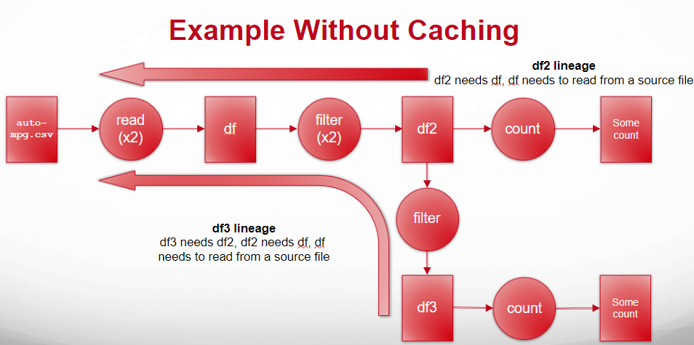

Slide 7
Example With Caching
The DataFrame ‘df’ is cached so it will only be read once.
df = spark.read.format("csv").option("header",\ 'true’).load("/Users/nachdaph/auto-mpg.csv").cache()
df2 = df.filter(col(”mpg") < 50).cache()
count = df2.count()
df3 = df2.filter(col(‘horsepower’) > 25)
count = df3.count()
The DataFrame ‘df2’ is cached so the filter() operation will only be executed once

Slide 8
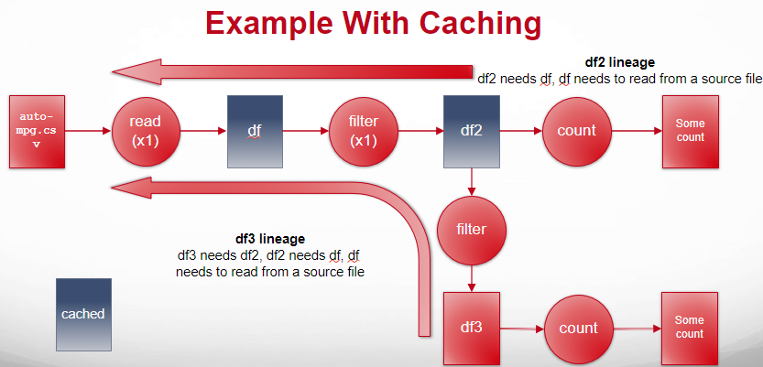

Slide 9
Best Practices for Caching
Cache only the data that you need
Cache only frequently accessed data
Release cached data when no longer needed
Caching too much data can lead to memory pressure on the worker nodes and degrade performance
If you will not reuse a DataFrame, there’s no reason to waste storage space by caching it
It's important to release cached data when it is no longer needed to free up memory resources on the worker nodes

